Slide 1
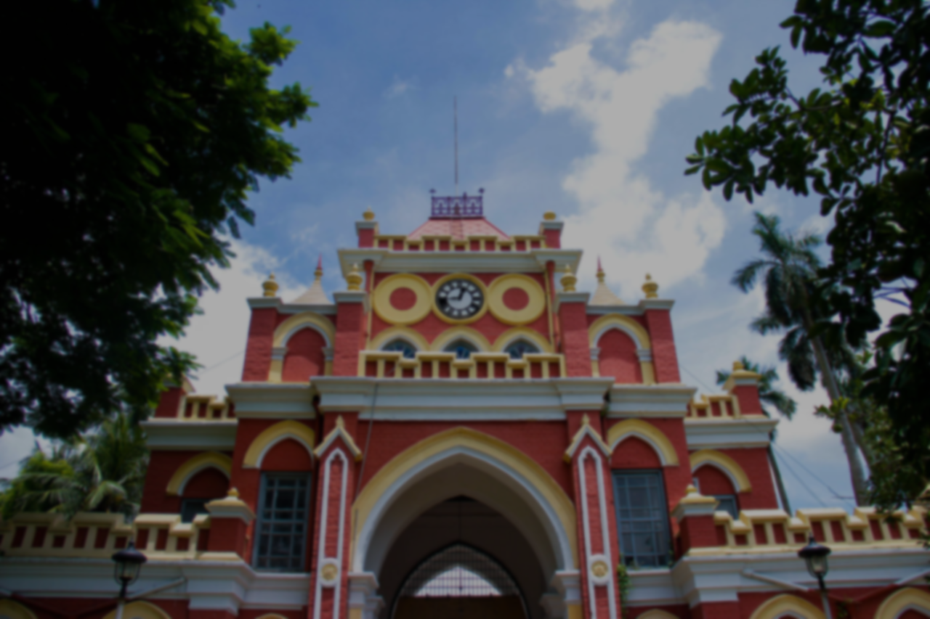
Natore
District
Presented By
MD. SHOHANUR RAHMAN SHOHAN
22-46013-1

Slide 2

Introduction
Natore district, a beautiful and historic place in Bangladesh. Natore is located in the northern part of the country, and it is home to a rich culture and history. I'll be discussing the geography, demographics, economy, historical sites, and famous food of Natore. I hope you'll enjoy learning more about this amazing place.

Slide 3

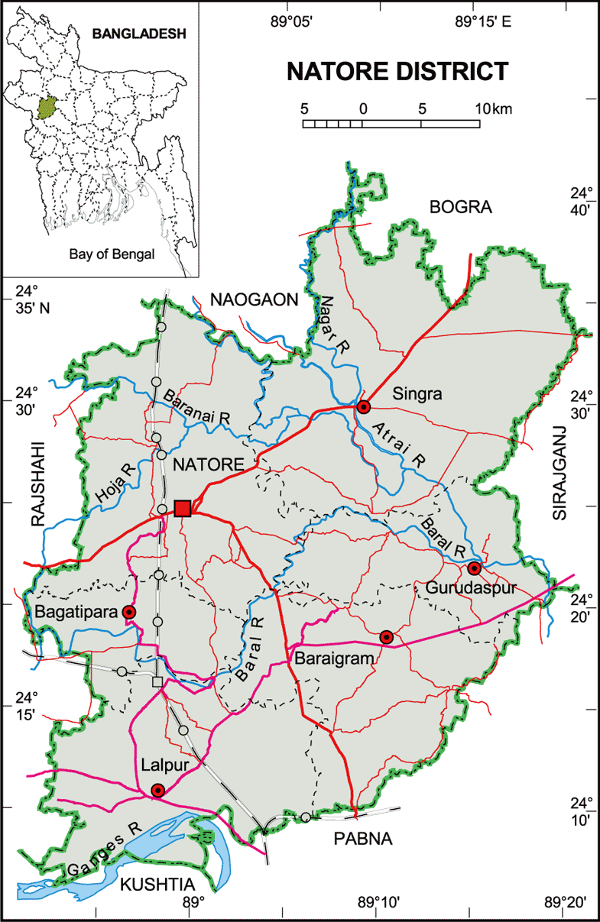
Geography
Natore district is located in the northern part of Bangladesh. It is the part of the Rajshahi Division. The district covers an area approximately 1900.05 square killometers. Major rivers of Natore include Musakhan, Nandaku, Barnan, Godai, Baral, Khalisadanga, Gunai, Narada River. It is bordered by Naogaon and Bogra districts to the north, Pabna and Kushtia districts to the south, Pabna and Sirajganj districts to the east, and Rajshahi district to the west.

Slide 4



Administrative Structure
Natore was the district headquarters of Rajshahi from 1769–1825. At the eve of that replacement, Natore was declared as a Subdivision. That event made Natore the first Subdivision of Bangladesh. Natore was established as a district in 1984.
Upazila
Pourasava
Bagatipara Upazila
Baraigram Upazila
Grudaspur Upazila
Lalpur Upazila
Naldanga Upazila
Natore Sadar Upazila
Singra Upazila
Bagatipara Pourasava
Bonpara Pourasava
Bagatipara Pourasava
Grudaspur Pourasava
Lalpur Pourasava
Naldanga Pourasava
Natore Pourasava
Singra Pourasava

Slide 5

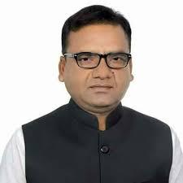

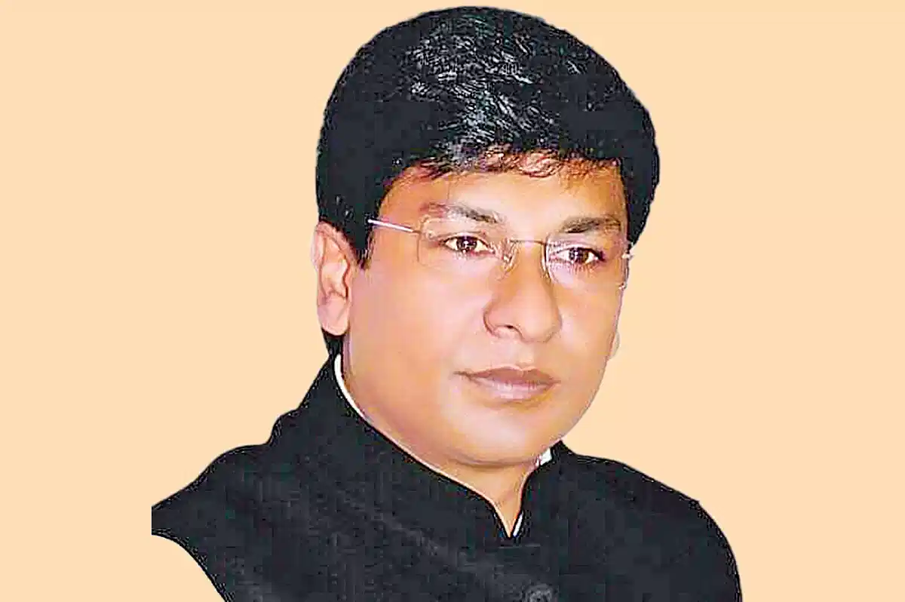

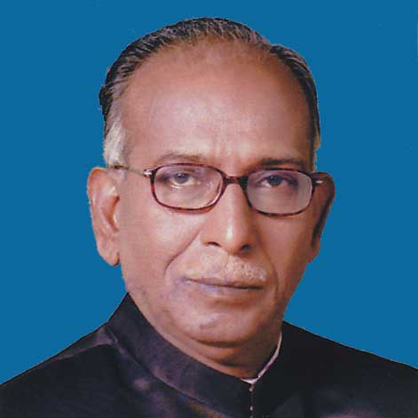
Member of Parliament
Md. Shihedul Islam (Bakul)
Natore - 01
Party – Bangladesh Awami League
Shafiqul Islam Shimul
Natore -02
Party – Bangladesh Awami League
Zunaid Ahmed Palak
Natore – 03
Party – Bangladesh Awami League
Md. Abdul Quddus
Natore – 04
Party – Bangladesh Awami League

Slide 6




Demographics
According to the 2011 Bangladesh census,
Population -
Total Population – 1.70 Million (1,706,673)
Male – 0.854 Million (854,183)
Female – 0.852 Million (852,490)
Literacy Rate -
Literacy rate of 49.59% for the population 7 years and above
Male – 51.90%
Female – 49.10%
Religions -
Muslims – 93.22%
Hindus – 6.08%
Christians – 0.47%
Others – 0.23%

Slide 7

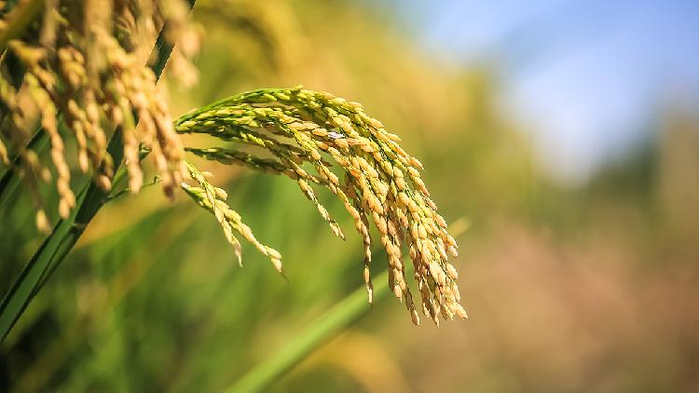
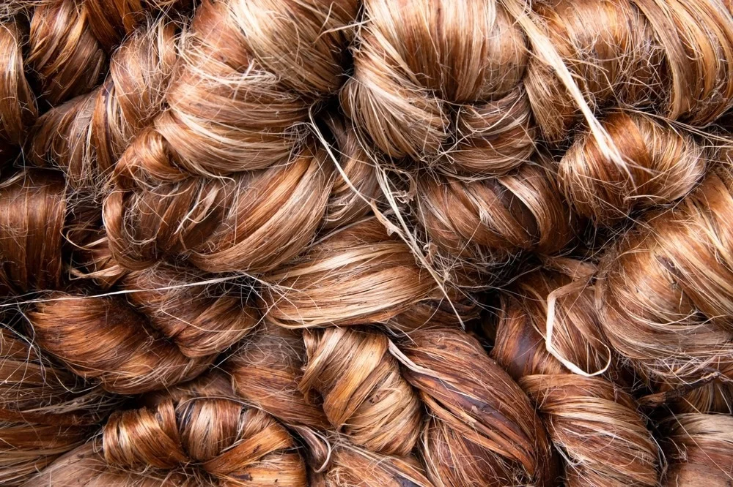
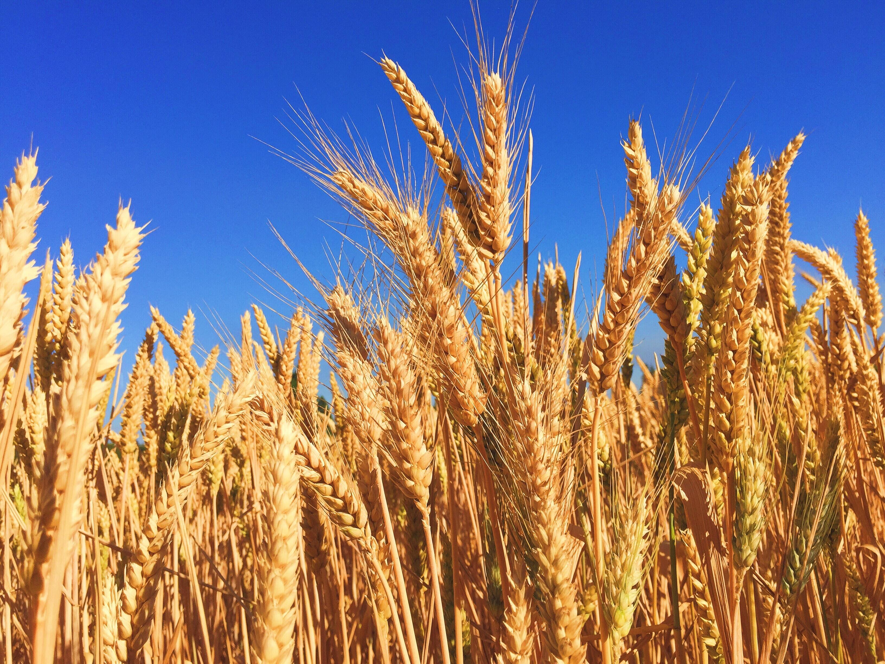
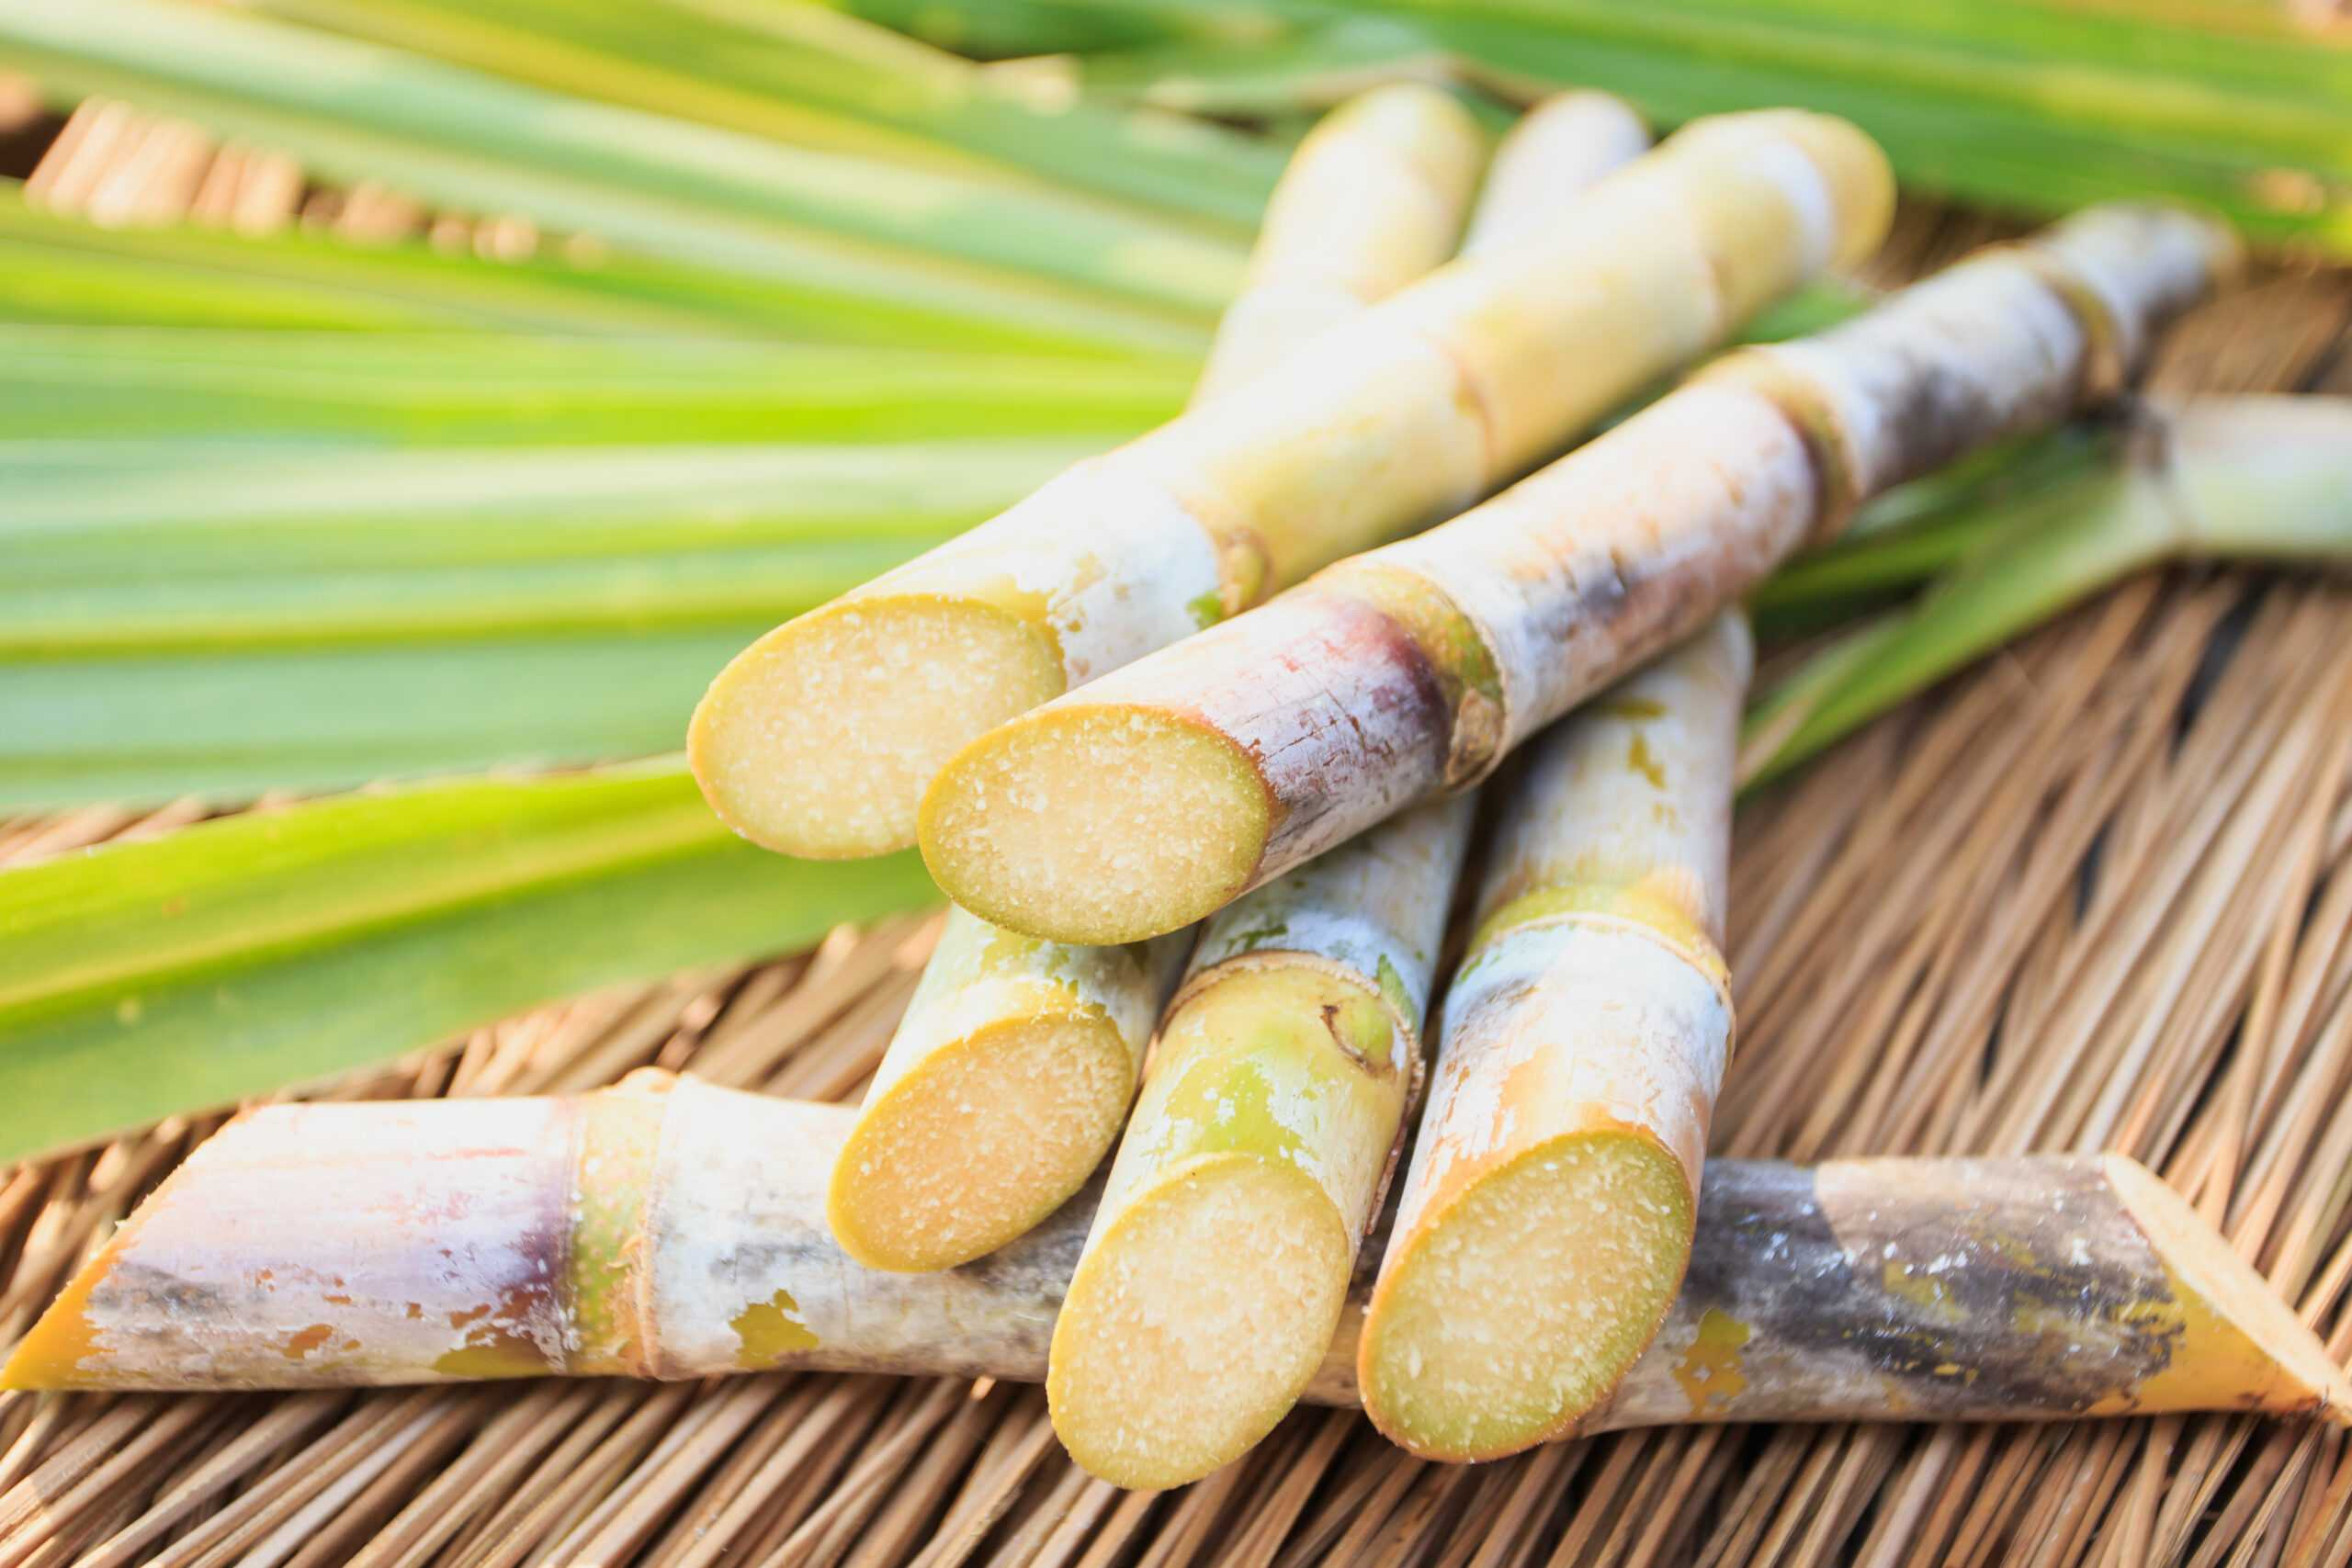
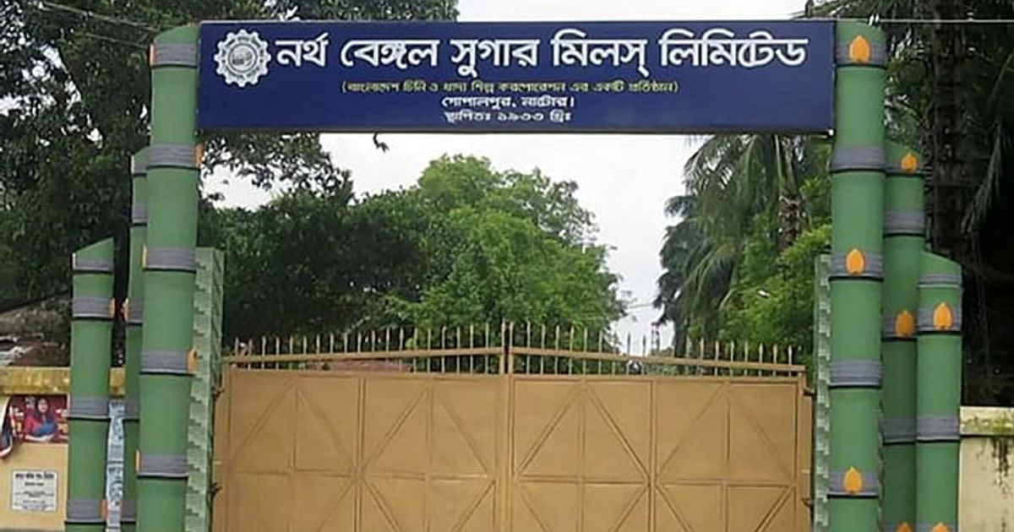
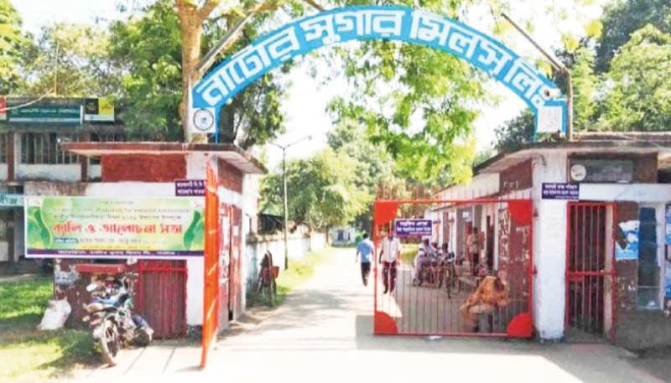
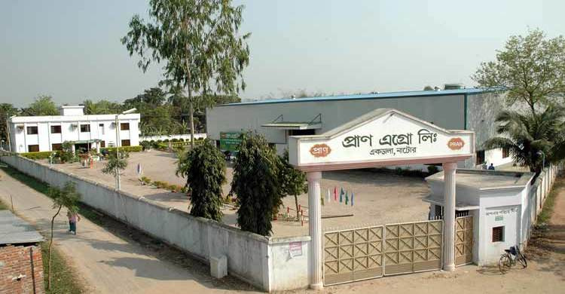
Economy
The economy of Natore is based on agriculture like Rice, Jute, Wheat, Sugarcane etc.
There are 2 sugar mills in Natore; North Bengal Sugar Mills Limited and Natore Sugar Mills Limited. They are the enterprises of the Bangladesh Sugar & Food Industries Corporation. Pran Agro Ltd. is a private food manufacturing plant of Pran-RFL Group. Jamuna Distillery Limited (1995) is another private industry of Jamuna Group. The distillery produces industrial alcohol, and is situated near Natore Sugar Mills Limited.

Slide 8


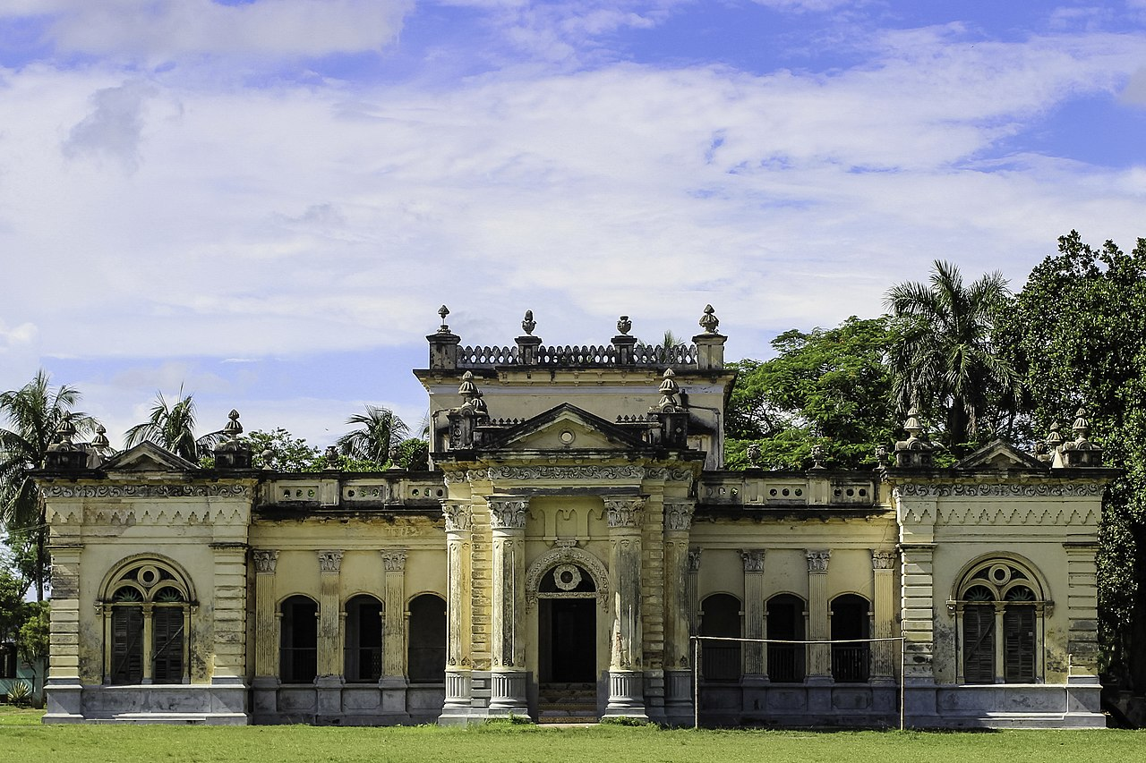
Historical Sites
Natore Royal Palace
Natore Royal Palace is located in Natore Sadar. It is also known as Rani Bhabani Rajprasad. It was the residence and seat of the Rajshahi Raj family of zamindars. Famous queen Rani Bhabani lived here and after the death of her husband, expanded both the estate and the palace. Natore Zamindari was one of the largest Zamindaris of bengal.

Slide 9
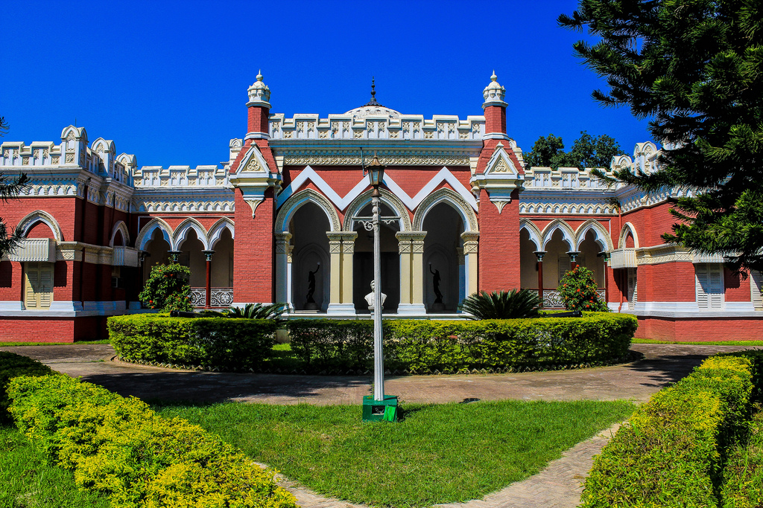
Historical Sites
Uttara Ganabhaban
Natore Royal Palace is located in Natore Sadar. It was known as Estate Rajbari during the British and Pakistan period, was the palace of the Maharajas of Dighapatia. The government is now using the palace as the official residence of the head of the government of Bangladesh in the northern region. This is a historic place widely visited by tourists.

Slide 10


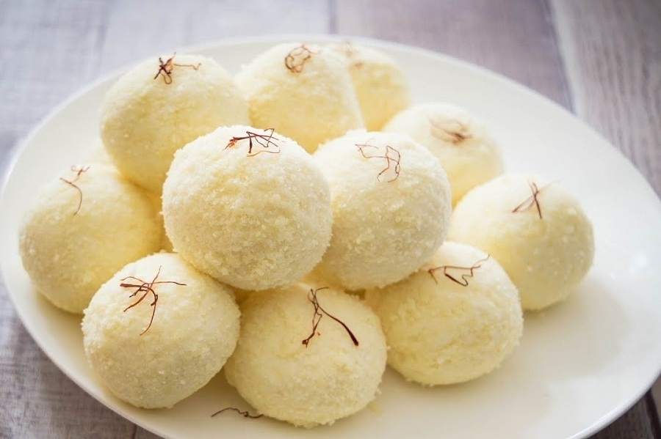
Famous Food
Kacha Golla
Natore is famous for one thing, and that is Kacha Golla of Natore. This is a sweet made from cheese curds and sugar. The best Kacha Golla can be found from the Lalbazar near (where the Joy Kali bari temple is located).

Slide 11

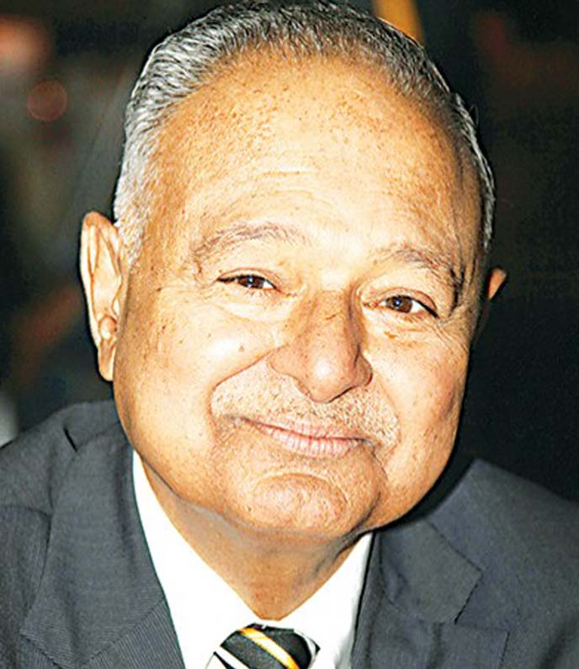




Renowned Personalities
Major General Amjad Khan Chowdhury (Retd)
Retired Army Person
Founder & Ex-Chairman of PRAN-RFL Group
Zunaid Ahmed Palak
Minister of State for ICT Division, Bangladesh
Taijul Islam
Cricketer of Bangladesh National Cricket Team

Slide 12

Conclusion
In conclusion, Natore is a fascinating place with a lot to offer visitors. It is a great place to learn about Bangladeshi culture and history, and it is also a great place to relax and enjoy the natural beauty of the country. I hope you'll have the opportunity to visit Natore someday.

Slide 13
THANK YOU

